Slide 1

Context of Business
1

Slide 2

Important Contacts
Administrative & Attendance
allenquiries@lsclondon.co.uk
Student Finance
Student.finance@lsclondon.co.uk

Slide 3
Student Finance Queries
Skype ID - chat and online calls : lscstudent.finance@outlook.com
Email: student.finance@lsclondon.co.uk
SMS (Phone) numbers:
07771 928394
07810 092517
07771 928407
Any admin queries: allenquiries@lsclondon.co.uk
@Copyrights LSC Group. All Rights Reserved

Slide 4
1) Student Finance - (SLC queries)
Zoom Link: https://zoom.us/my/lsc.studentfinance
Working Hours: (Mon-Fri)
11:00 a.m. to 1:00 p.m.
3:00 p.m. to 5:00 p.m.
2) Accounts (NON SLC related payments)
Zoom Link: https://zoom.us/my/lsc.accounts
Working Hours: (Mon-Fri)
11:00 a.m. to 1:00 p.m.
3:00 p.m. to 5:00 p.m.
3) Registry - (attendance, portal, timetables, assignment briefs)
Zoom Link: https://zoom.us/my/lsc.registry
Working Hours: (Mon-Fri)
10:00 a.m. to 1:00 p.m.
3:00 p.m. to 5:30 p.m.
4) Exams - (results, submissions)
Zoom Link: https://zoom.us/my/lsc.exams
Working Hours: (Mon-Fri)
11:30 a.m. to 1:00 p.m.
3:00 p.m. to 5:30 p.m.

Slide 5
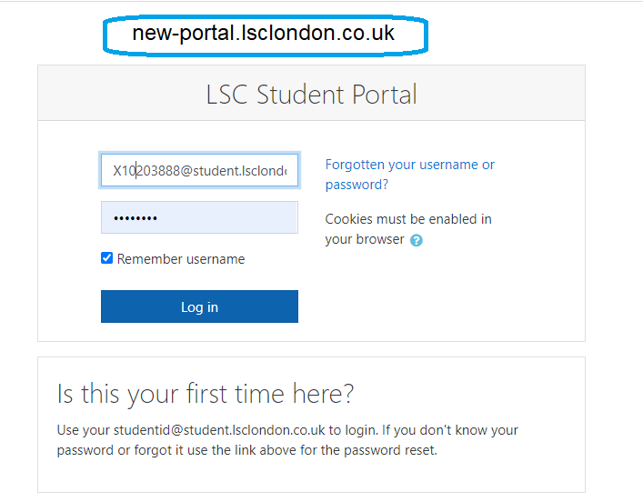
Example for Student ID S89535 @student.lsclondon.co.uk

Slide 6
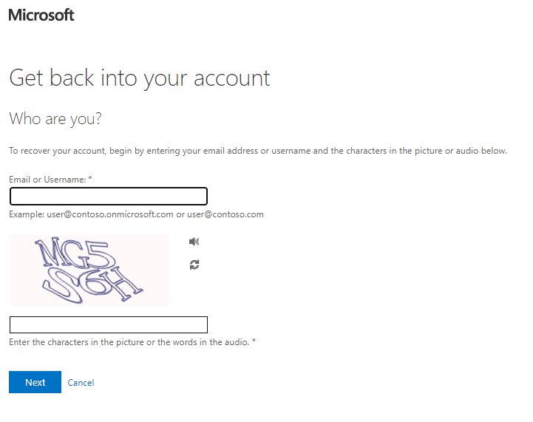
Use your school email ending @student.lsclondon.co.uk
Example ID S89535@student.lsclondon.co.uk

Slide 7
Context of Business
Course Content
Schools of Management
Business Environment
Management and Leadership
Economic Environment
Culture and management
Decision Making
Foundations of legal frameworks
Motivating in Organisation
Ethics and Responsibility
Globalisation and management

Slide 8
Learning Objectives
LO1: Understand the dynamic and changing nature of business and the consideration of the future of organisations within the global business environment
LO2: Identify the need for individuals and organisations to manage responsibly and sustainably and behave ethically in relation to social, cultural, economic and environmental issues
LO3: Discuss leadership, management and development of people
LO4: Discuss the development of appropriate policies and strategies within a changing environment to meet stakeholder interests
LO5: Be aware of the design and development of organisations
Assessments
Component number | Form of assessment | Word count | Weighting (%)
1 | Case Study | 2500 – 3000 words | 100

Slide 9

Schools of Management

Slide 10
1
A Brief History of
Management’s Roots

Slide 11
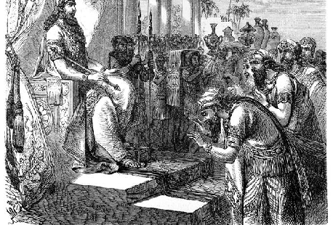

Early Management
Management has been practiced a long time.
Construction of Pyramids, Hammurabi Codes for example would have taken considerable management skills
Issues facing Management has not changed much over time
Management endeavours directed by people who are responsible for planning, organising, leading and controlling have existed for thousands of years

Slide 12
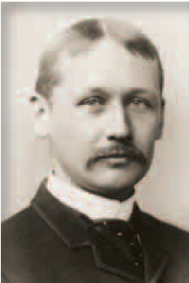
Classical Approaches
Scientific Management
Frederick W. Taylor in 1909 described scientific management as a method of scientifically finding the “one best way to do a job”
Through optimization, it is possible to improve productivity
Taylor believed all workers are motivated by money and continuous employment is a motivator

Slide 13
Scientific Management
Four Principles of Scientific Management
1
Use of Scientific approach through most efficient way to perform task improved productivity
2
Allocate tasks to employees based on their skills and capability to maximize efficiency
3
Monitor the performance of the employees as employees are not ‘capable’ of performing efficiently without supervision
4
Allocate tasks to managers involving planning, training and monitoring while employees work towards the efficiency

Slide 14
Scientific Management
Main Criticisms of Scientific Management
The theory does not provide scope to improvements and innovations
The theory assumes employees cannot function unsupervised
The theory does not factor globalisations and cultural differences
The pursuit towards extreme efficiency cannot be sustained over long term

Slide 15
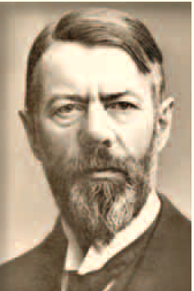
Other Classic Approaches
General Administrative Theory
focused on what constituted good management
Max Weber (pictured) described the bureaucracy as an ideal rational form of organization
Henri Fayol identified five management functions and 14 management principles

Slide 16
14 Principles of Henry Fayol
Division of Work
Centralisation
Authority and Responsibility
Scalar Chain
Discipline
Order
Unity of Command
Equity
Unity of Direction
Stability of Tenure
Shared interest
Initiative
Remuneration
Esprit De Corp

Slide 17
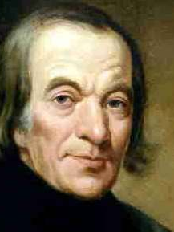
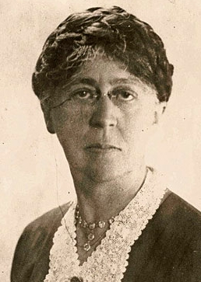
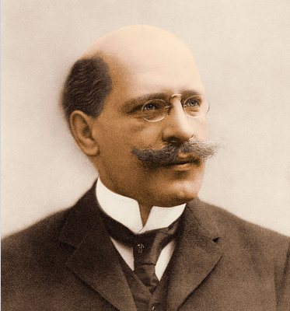
Behavioral Approaches
Early management writers included
Robert Owen, was concerned about deplorable working conditions
Hugo Munsterberg, a pioneer the field of industrial psychology
Mary Parker Follett recognized what organizations could be viewed from both individual and group behavior.

Slide 18
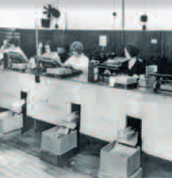
The Hawthorne Studies
Conducted at the Western Electric Company Works these studies:
Provided new insights into individual and group behaviour in the behaviour of people at work.
Concluded that group pressures can significantly impact individual productivity

Slide 19
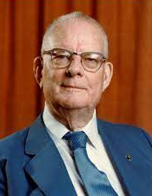
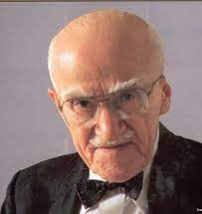
Quantitative Approaches
Quantitative Approach
Evolved from mathematical and statistical solutions developed for military problems during World War II
Used quantitative techniques to improve decision making
W. Edwards Deming and Joseph M. Juran ‘s ideas became the basis for total quality management (TQM)

Slide 20
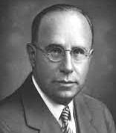
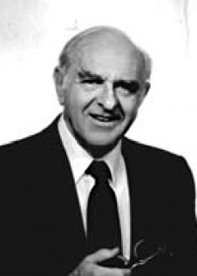
Contemporary Approaches
Focused on managers’ concerns inside the organization
Chester Barnard wrote in his 1938 book The Functions of the Executive that an organization functioned as a cooperative system
Fred Feildler first popularized the contingency approach (or situational approach) which says that organizations, employees, and situations are different and require different ways of managing

Slide 21
Thank You

